Slide 1
Hackathon workshop Credit fintech industry
Aditya ravichandar

Slide 2
The agenda for this project is to predict the loan_status i.ie. to find out whether the loan_status is charged and fully paid for all the rows or samples in the dataset.
I used google colaboratory as the software to do the project.
Reference : https://colab.research.google.com/drive/1_ymQQDt7RZNmLG8rnuRpCtvI2-AibDHL#scrollTo=62_V2xbjd5Qn

Slide 3

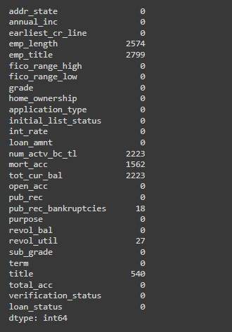
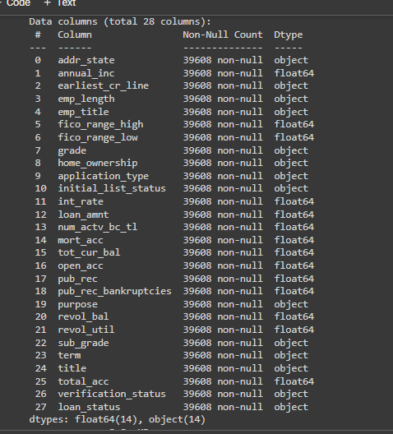
Data exploration is used as the 1st step of preprocessing.
I used describe() and info()
.shape command to find the no of rows and columns.
The purpose of data exploration is to gather more details about the dataset.
These are insights

Slide 4
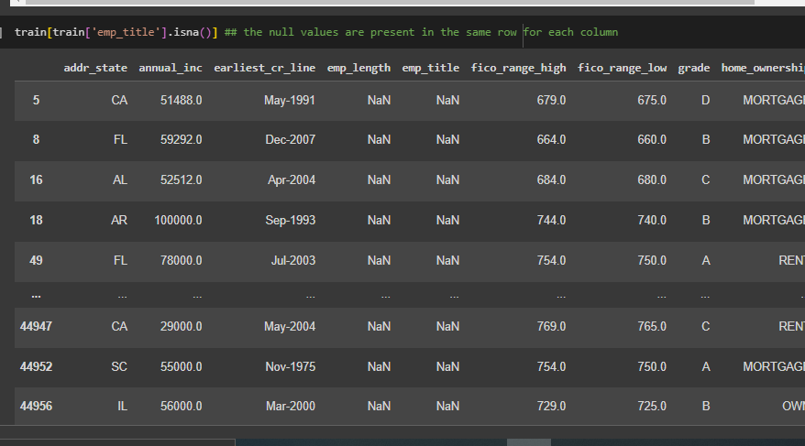

2nd step of preprocessing is the handling of null values and duplicates. The reason is that missing values can disturb the overall performance of the dataset. Based on the null values and duplicates we identify them by using isna() and duplicates(). These are the insights which i gathered for this project.
insight i gathered is the null values for some columns are present on the same rows. so we need to use the dropna to remove them. There are no duplicates. Below are the following for the insights.

Slide 5
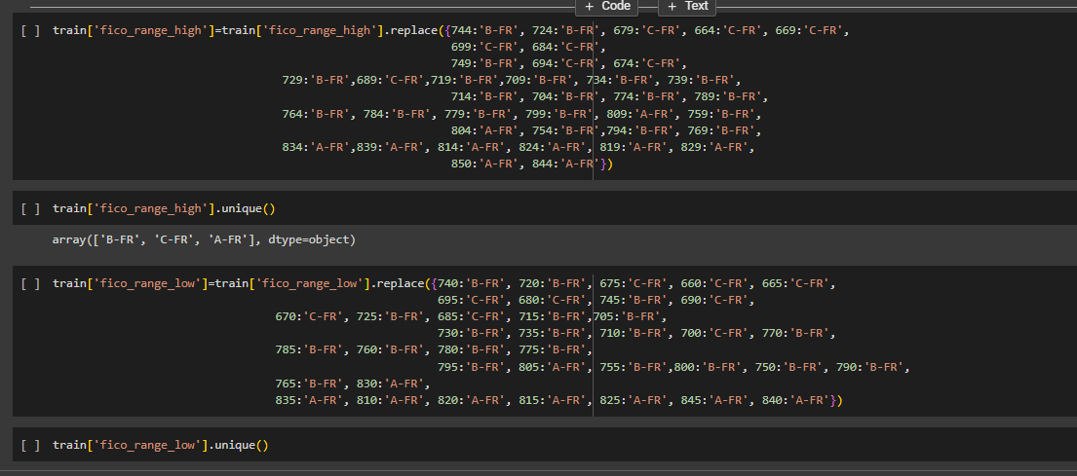
3rd step i used text error correction to correct all the values and change the values for easier analysing and classification of some columns and thier rows.
I classified the numbers of (fico range high and fico low range in this format
classification or grouping of fico range:
801-900 : 'A-FR'
701-800 : 'B-FR'
601-700 : 'C-FR'
I have deleted the columns like subgrade, purpose,emp_title and title because t.hese columns are not essential.

Slide 6
for verification status there were 3 unique values Source verified, verified and not verified. So what i did was i converted ‘Source verified’ as verified by using replace command.
for emp length we have to convert the >10 yrs as 10 as an integer and same for other nos ranging from 0-10.
we have to convert some columns like pub_rec,pub_recbankruptcies as int because it was in float.

Slide 7
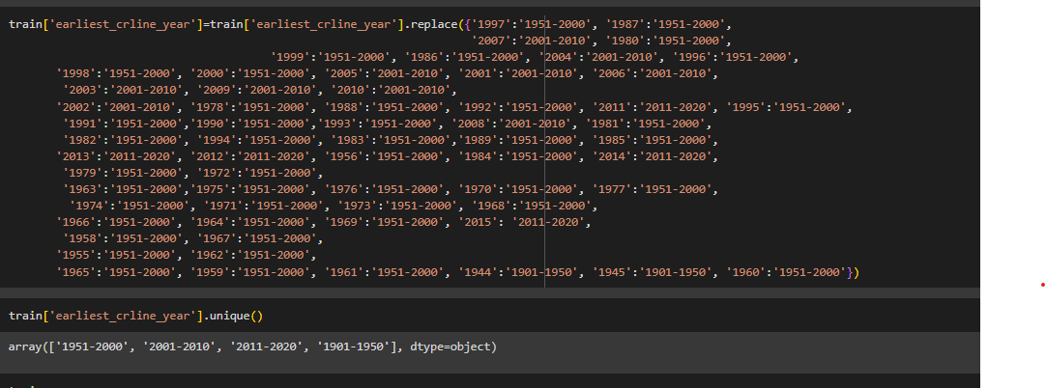
in earliest _cr_line they have given the format as Jul-1997 so i Seperated this into 2 seperate columns like earliest _cr_linein yrs and earliest _cr_linein mths by using commandas like .apply(lambda x:x.split()[0]) and .apply(lambda x:x.split()[0]). I used this command even for the column term in months.
for earliest _cr_linein yrs i classified into 4 different groups '1951-2000', '2001-2010', '2011-2020', '1901-1950'. for better understanding and clarity.
for emp length we have to convert the >10 yrs as 10 as an integer and same for other nos ranging from 0-10.
we have to convert some columns like pub_rec,pub_recbankruptcies as int because it was in float.

Slide 8
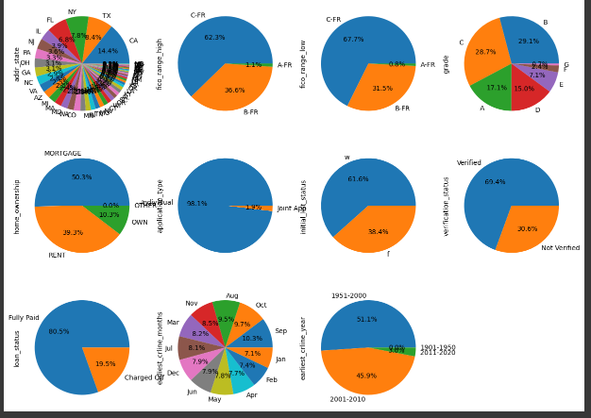
I seperated the train dataset in to 2 columns number dataset and categorical dataset.
Used eda analysis for analysing all the columns by using pie chart command.

Slide 9
To be done for classification
Supervised learning algorithms:
KNN (kd tree algorithm) classifier
decision tree classifier
random forest classifier
logistic regression

Slide 10
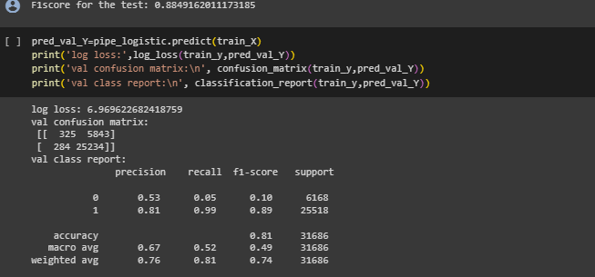
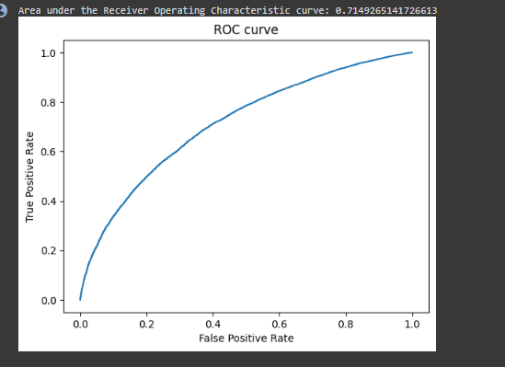
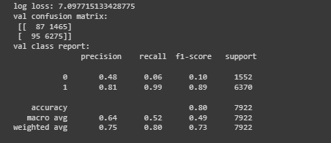
I had to do pipelining for both cat_cols and num_cols.
Before doing pipelining based on logistic regression and polynomial features i had to convert for both the unique values Charged and fully paid of the loan status columns as 0 and 1 for finding the net log loss of logistic regression. Also i had to do train and test split method based on this pielining.
I did find out logistic regression , polynomial features degree 2 using pipelining.
I found out the confusion matrix, classification report and accuracy score and net log loss and true positive rate or F1 score for both train and test
I plotted the graph of logistic regression and area under the charateristic curve.

Slide 11
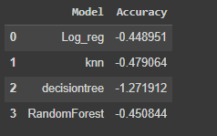
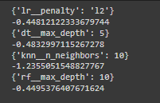
I did multi model pipelining for logistic regression, random forest classifier, decisiontree classifier, Kneighbors classifiers, and then I did grid search and hyper parameter tuning based on these 4.

Slide 12
things which i was not able to work on
I was not able to work on boosting because the reason is that the dataset consists of over 900000 samples which is highly complicated. Even by doing random sampling, under sampling also it did not work it is over complicated to do boosting method.

Slide 13
Lessons which i learnt from this hackathon
The lesson which i learnt is that i had to use very less no of rows for producing correct results for all supervised learning algorithms except the boosting method
The decision for selection of columns which has to be choosen or deleted out of 28 columns
The reason for using very less no of rows is that it consists of more than 9 lkh rows because of which many instances has happened like for instance computer got crashed while doing grid search and parameter tuning and boosting.

